Slide 1
Risk of Endangerment Analysis
Vy Nguyen
Braydon Nugent
Alex Feeney

Slide 2

Context
There is limited understanding of biodiversity decline around the world.
There is no real intention for people to understand the severity of the situation.
A practical & visual representation seemed appropriate.
Notes:
The conservation of species and biodiversity holds significant importance due to various reasons, including the maintenance of biodiversity, economic value, contributions to scientific and medical discoveries, and mitigation of climate change. Unfortunately, biodiversity loss is a multifaceted issue influenced by both natural and human-induced factors. Collecting data on species categorized as threatened, vulnerable, endangered, and critically endangered from diverse regions is crucial for understanding the extent of the problem. However, the absence of a dedicated platform for data visualization has posed challenges for conservationists and hindered effective decision-making and public education initiatives. Establishing a comprehensive platform for visualizing this data is essential for facilitating informed decision-making and enhancing public awareness.

Slide 3
Aims:
To provide a user friendly experience to entice the public on understanding the issue.
Converting an abundance of scripted data, to an accessible and digestible visualisation.
These visualisations will demonstrate:
Regions of significance
Quantities of potential biodiversity extinction (and to what extent).
Comparable data (displayed on the ‘Known Species’ dataset).
What species classes are at more of a risk around the world.

Slide 4
Strategy:
Establish SQLite database.
Develop API endpoints to facilitate data retrieval.
Create clear & user friendly visualisations.
Create webpage & essentially append all of the above.

Slide 5
Step 1: Build a SQLite database
Data
Threaten species data - Threatened species (oecd.org)
Data Cleanup
Excel
Python - Pandas package
SQLite
Import data
Change data type
Set key
Create database

Slide 6
Step 2: Create API endpoints
API endpoints
http://127.0.0.1:5000/api/endangeredSpecies
[ {
"country": "Australia",
"species": "Mammals",
"value": 41
}, … ]
Data
SQLite database
Tools
Python
SQLAlchemy
Flask

Slide 7
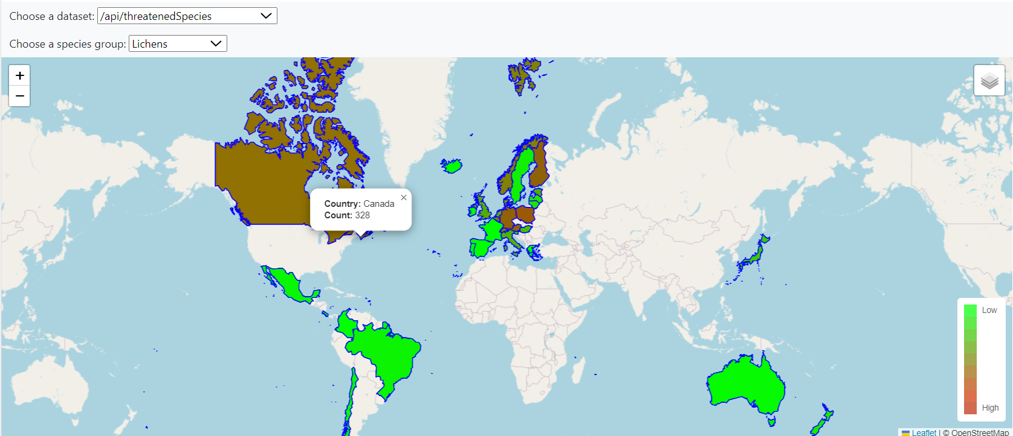
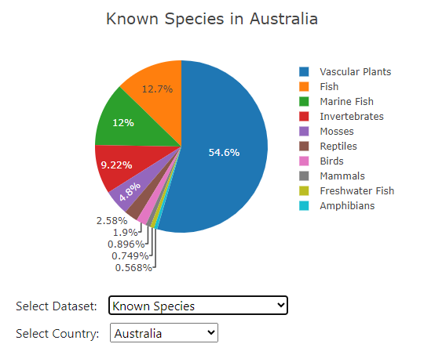
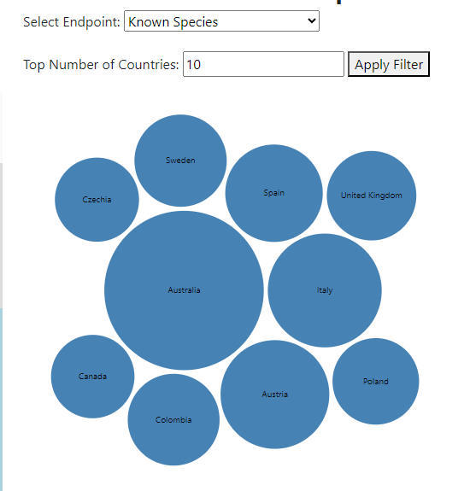
Step 3: Create visual maps/ charts
Data
API endpoints
GeoJson
Tools
Leaflet map
D3.js
Plotly

Slide 8
Step 4: Create a website to display visual objects and allow user’s interaction
Live Demonstration
app.py
app.js
style.css
index.html
API
Data access and retrieval
Visual objects
Style and formatting for the web page
Structure and content of the web page

Slide 9
Acknowledgment

